Slide 1
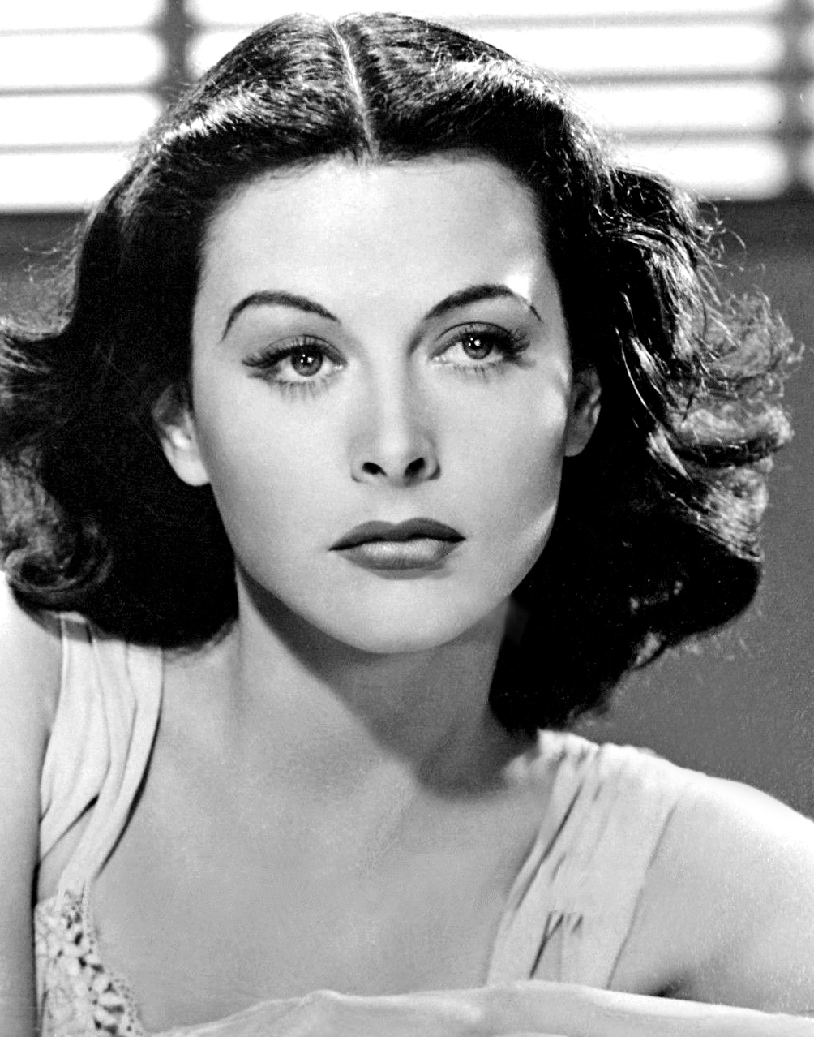
Hedy Lamarr
The world’s most beautiful woman
Kriszgruber Laura – Juillet 2024

Slide 2
Agenda
Biography
Snow White
Q&A
Sources

Slide 3
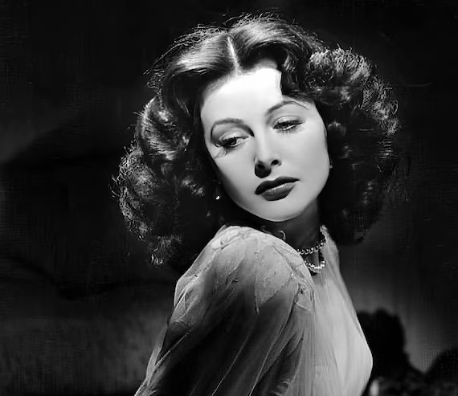
Biography
1914
Born Hedwig Kiesler in Vienna in 1914
1933
Nude Scene in "Ecstasy"
1937
Fled her marriage in 1937
1940
Became the most famous and glamourous women in Hollywood
19 Jan. 2000
Died on January 19, 2000
Notes:
1914 Born to Jewish parent and Jewish herself which posed significant challenges due to the rising anti-Semitism in Europe
1933 Nude in Ecstasy -> global fame also brought controversy and public scrutiny. as a scandalous figure
1934 actress in Austria and married to Friedrich Mandl, ammunation manufactureur whom she suspected to sell to Nazi Germani and Italia
1937 Fled disguised as a maid with jewelerry sen into coat in the US -> Hedy Kiesler had a new name and one of the highest salary contracts ($3,000 per week by today’s standards) for any starting actress in Hollywood.
She quickly became known for her stunning beauty and appeared in several successful films in the 1940s.
An adaptation of John Steinbeck’s Tortilla Flat (1942), White Cargo (1942), Cecil B. DeMille’s Samson and Delilah (1949), and The Female Animal (1957).

Slide 4
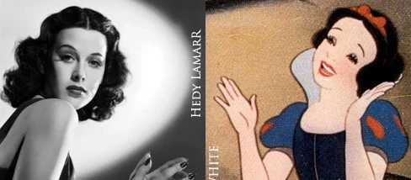
The face of Snow White
Notes:
The beautiful face of Walt Disney's Snow White was inspired by Hedy Lamarr, long considered the most beautiful woman in the world. Wait this is a **tech** talks no ? So why am I speaking about an Hollywood actress as pretty as she is ? Anybody has an idea why ?

Slide 5
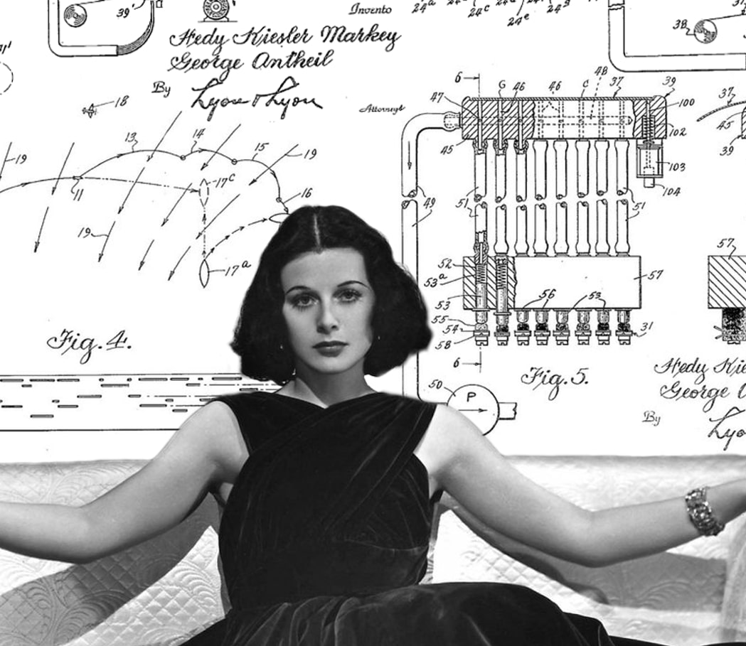
Why Hedy Lamarr ?
Notes:
Lamarr kept a secret few people cared about: she was an inventor. Gifted mathematician, scientist, and innovator. Alongside the famed composer George Antheil, Lamarr patented the "Secret Communication System" during World War II. "frequency hopping"

Slide 6
Agenda
Biography
Snow White
Why Hedy Lamarr ?
Secret Communication System
Frequency Hopping ?
Limitations of the time
Awards
Today
Trivias
Q&A
Sources

Slide 7
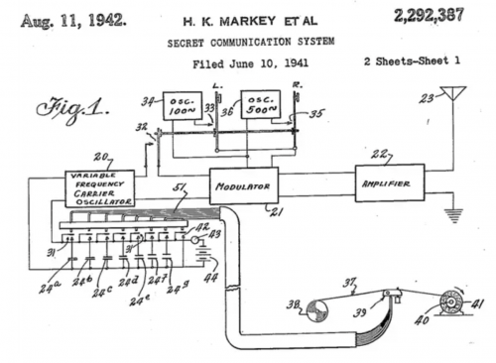
Secret communication system
Called today frequency hopping
Schematic for the
Secret Communication System
7
Notes:
Alongside the famed composer George Antheil, Lamarr patented the "Secret Communication System" during World War II
It pertained to a way for radio guidance transmitters and torpedo's receivers to jump simultaneously from frequency to frequency.

Slide 8
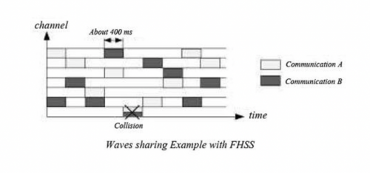
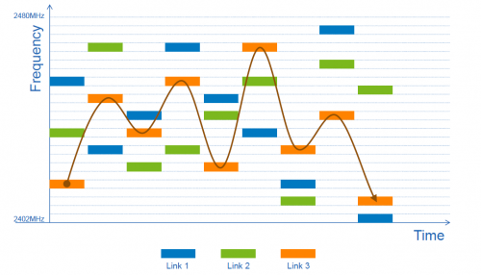
Frequency Hopping ? (FHSS)
Schemas of FHSS
8
Notes:
Frequency-hopping spread spectrum
Her most famed idea, and her only patented invention, is known as “frequency hopping,” a telecommunications technology that uses a code which jumps between different radio wave frequencies. This “hopping” allows for complicated transmission and communication of secure information between devices.
Frequency hopping is a method of transmitting radio signals by rapidly switching a carrier among many frequency channels, using a pseudorandom sequence known to both transmitter and receiver. This technique reduces interference and makes eavesdropping and jamming difficult.
Spread Spectrum: Frequency hopping is a type of spread spectrum technique, which spreads the signal over a wide bandwidth, making it more resistant to interference and interception.
Implementation: Lamarr and Antheil’s system used a piano roll to switch between 88 frequencies (matching the number of keys on a piano). This rapid switching made the signal difficult to jam or intercept.
Lamarr developed the idea in her own effort to help end WWII, after she heard that 80 children died when a German torpedo struck the SS City of Benares, a passenger ship crossing from Britain to Canada.

Slide 9

Limitations of the time
Or why this ground-breaking technology sat untouched for nearly a decade ?
9
Notes:
Hedy Lamarr was confident in her abilities as an inventor and considered joining the Inventor’s Council in Washington DC.
She and George Antheil sent their patent for a communication system for torpedoes to the US Navy.
The Navy, skeptical about her having both beauty and brains, dismissed her idea, telling her to "just sell war bonds.“
As a result, her invention sat unused for nearly a decade due to both sexism and technological limitations of the time.
The feasibility of "frequency hopping" was initially hindered by the technology of the time.The advent of the transistor and its miniaturization later propelled Lamarr’s idea into use in both military and cellular technology.
In the 1950s, the Navy revisited her idea to develop “sonobuoys” for communication between aircraft and submarines.
Despite the renewed interest, Lamarr received no payment or recognition because her patent had expired.
Lamarr's experience underscores the challenges she faced as an underappreciated inventor and a wartime refugee.

Slide 10
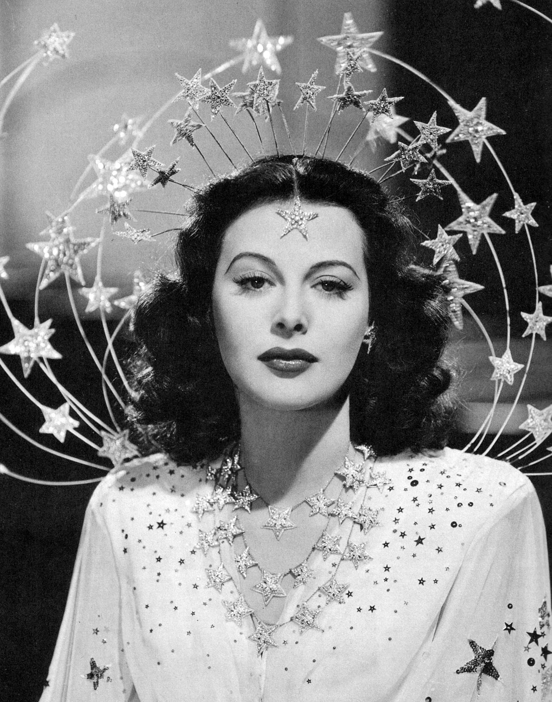
Awards
1997 EFF Pioneer Award
BULBIE Gnass Spirit of Achievement Bronze Award
2014 National Inventors Hall of Fame
10
Notes:
Hedy Lamarr has been posthumously recognized for her technological contributions.
1997, the Electronic Frontier Foundation (EFF) was the first to publicly acknowledge Lamarr for her invention by presenting her with the EFF Pioneer Award.
Later went on to be the first woman to receive the BULBIE Gnass Spirit of Achievement Bronze Award
2014 she was inducted into the National Inventors Hall of Fame.
her story has been told in documentaries like "Bombshell: The Hedy Lamarr Story," highlighting her dual legacy as both an actress and an inventor.

Slide 11
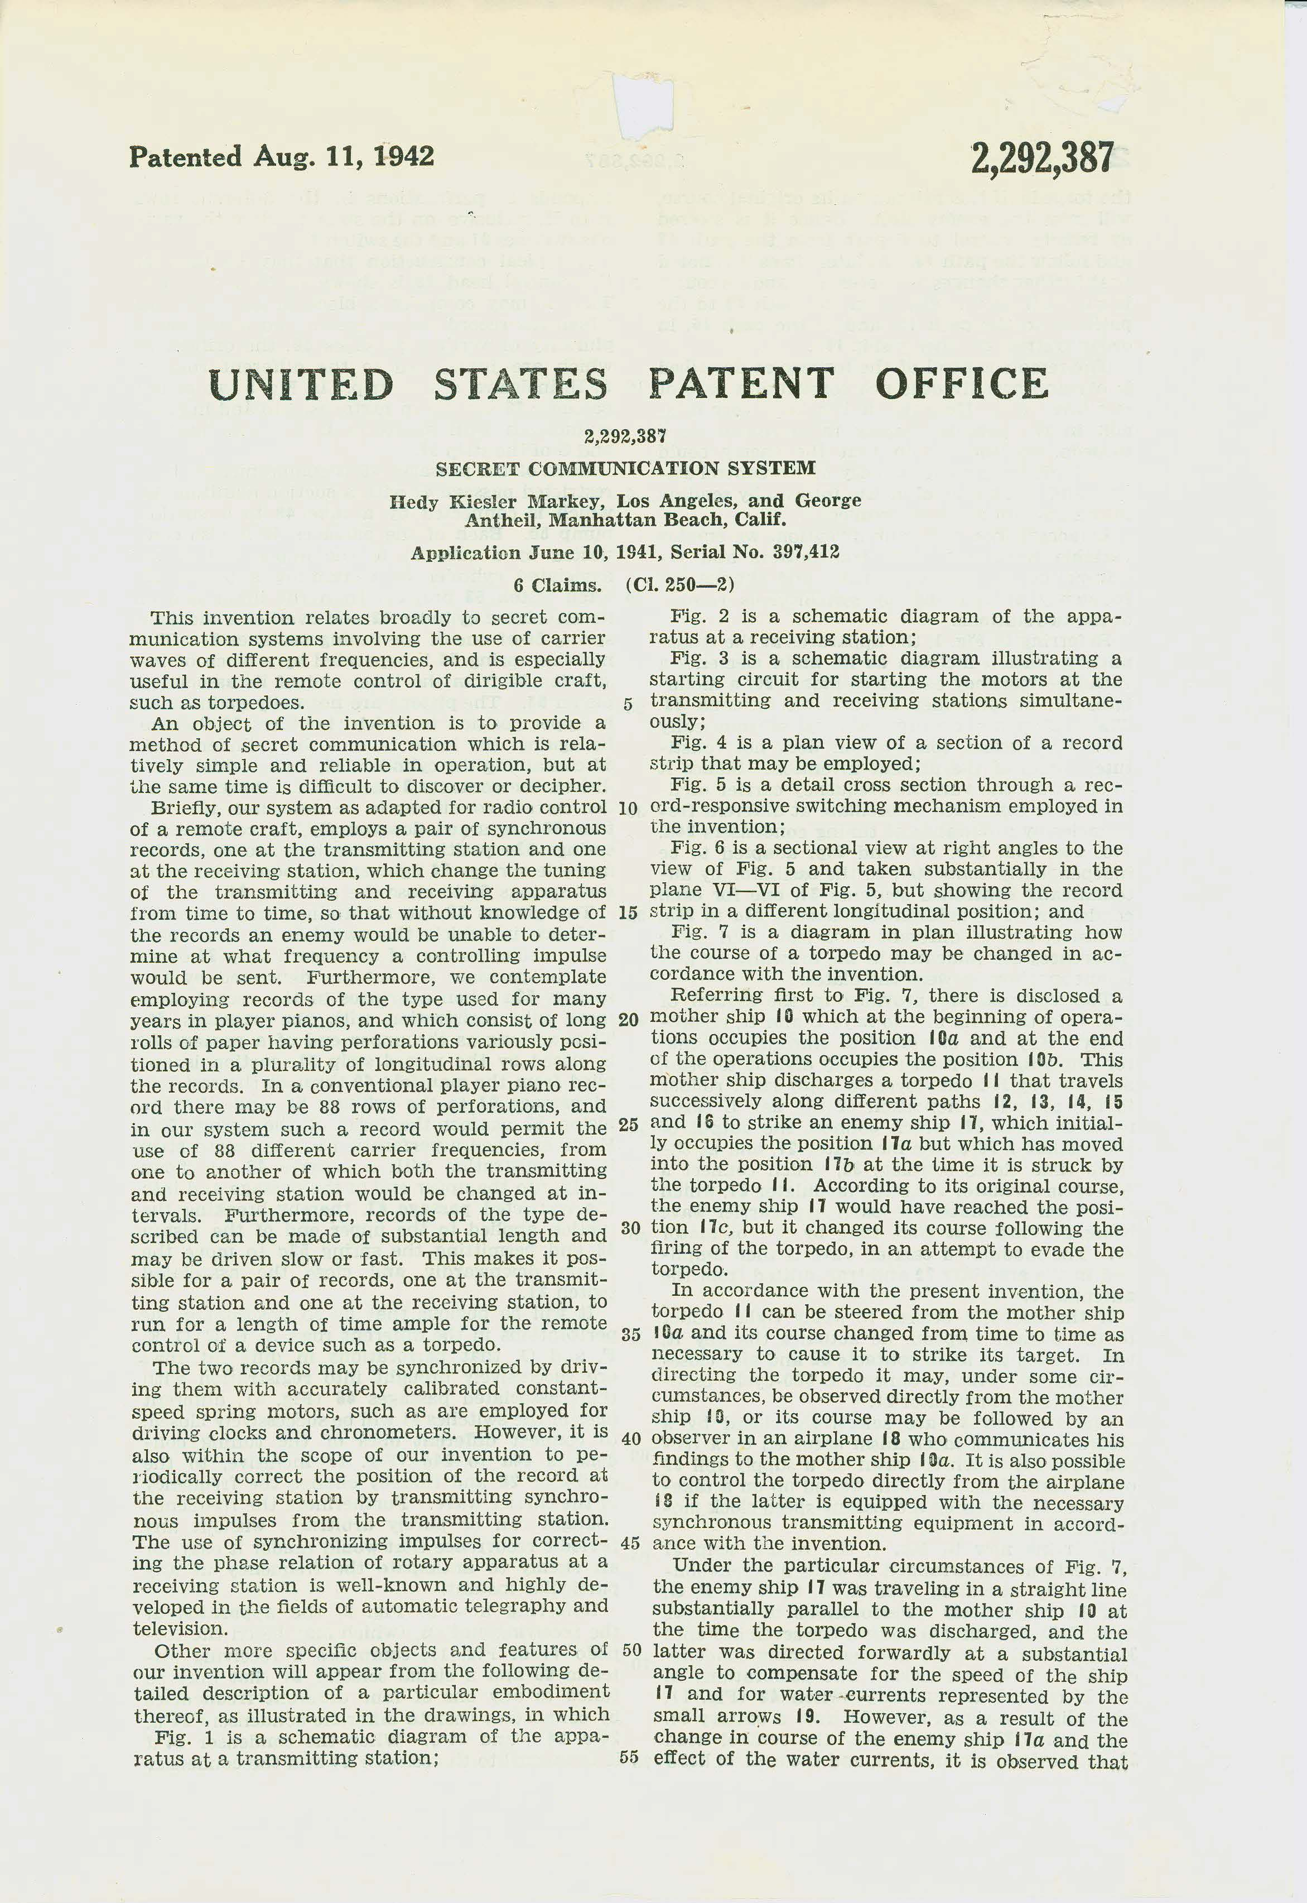
Today
Fax machines
Top-secret military
Diplomatic communications
GPS
Internet
Wi-fi
Satellite communication systems
Wireless communication
Patent for the Secret Communication System
11
Notes:
Over the course of the next six decades, Lamarr’s groundbreaking invention went on to serve as the foundation for a multitude of communication technologies, including fax machines, top-secret military and diplomatic communications, GPS, internet, Wi-Fi, satellite communication systems, and wireless communication, spawning significant advances in cyber security.

Slide 12
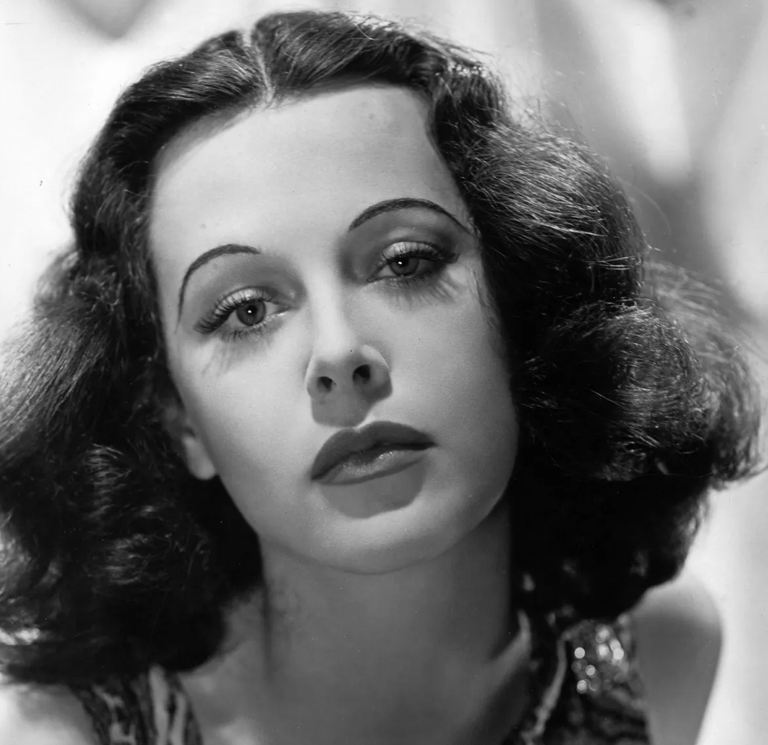
Trivia
Never formally educated in math or science
Married six times
Chess Enthusiast
Multilingual : German, French, English
2017 Bombshell : movie about her life
12
Notes:
Despite having never been formally educated in math or science,
In 2017, a biographical documentary called Bombshell came out about her life and accomplishments.

Slide 13
The biggest men and women with the biggest ideas can be shot down by the smallest men and women with the smallest minds. Think big anyway.
Bombshell: The Hedy Lamarr Story
Part of a poem read by Hedy Lamarr to her children in Bombshell: The Hedy Lamarr Story
Full poem : Here
13
Notes:
The biggest men and women with the biggest ideas can be shot down by the smallest men and women with the smallest minds. Think big anyway.
Poem read by Hedy Lamarr to her children in Bombshell: The Hedy Lamarr Story
In the documentary "Bombshell: The Hedy Lamarr Story," Lamarr reads a poem to her children that reflects her thoughts on ambition and creativity, emphasizing the importance of thinking big despite challenges and criticism.

Slide 14

Notes:
How did her background and early experiences influence her later work in Hollywood and as an inventor? Lamarr's early experiences, including her marriage to Friedrich Mandl, an Austrian munitions manufacturer, exposed her to military technology. Her intelligence and curiosity were further fueled by the limitations and struggles she faced, leading her to pursue inventing alongside her acting career.
How did Hedy Lamarr's role in the film "Ecstasy" impact her career in Hollywood? Despite this, it opened doors for her in Hollywood, where she was able to secure a contract and become a leading actress.
What were some of her most notable films and roles in Hollywood? She was renowned for her beauty and often played glamorous and exotic roles.
How did her personal life and marriages influence her career and inventions? Lamarr's tumultuous personal life often intersected with her career. Her marriage to Mandl exposed her to military technology, which later inspired her inventions. However, her personal struggles also sometimes overshadowed her professional achievements.
What inspired Hedy Lamarr to start inventing and working on technological innovations? Hedy Lamarr was inspired by her exposure to military technology through her first husband and her desire to contribute to the war effort during World War II.
Why was Hedy Lamarr's contribution to technology not recognized during her lifetime? Lamarr's contributions were overshadowed by her acting career and the pervasive gender biases of the time. Her work in technology was not taken seriously by many because she was primarily known as a glamorous actress.
What other cultural or societal impacts did she have outside of her film career and technological contributions? Hedy Lamarr's status as a Hollywood icon and her unexpected role as an inventor have made her a symbol of the often overlooked intellectual contributions of women, particularly in fields dominated by men.
How did Hedy Lamarr balance her acting career with her passion for inventing? Despite her demanding film career, Lamarr found time to work on her inventions during her downtime. She often worked late into the night on her ideas, showcasing her dedication to both her artistic and intellectual pursuits.
War bonds : War bonds are debt securities issued by a government to finance military operations and other expenditures in times of war. They are a means for governments to finance military operations by borrowing money from their citizens, who in turn show their patriotism and support for their country’s war efforts.
Public Appearances: Attending rallies, parades, and events to promote war bonds.
Radio Broadcasts and Interviews: Reaching a wide audience through radio and interviews.
Advertising: Her image was used in ads and posters to encourage purchases.
War Bond Drives: Participating in organized efforts to sell large amounts of war bonds.
Personal Engagement: Signing autographs and personally encouraging people to buy bonds.
Entertainment Events: Performing at events like Hollywood Canteen shows to promote war bonds.
Her star power and personal engagement helped raise significant funds for the war effort.

Slide 15

Thank you for listening!
Drawing by @ayunoko

Slide 16
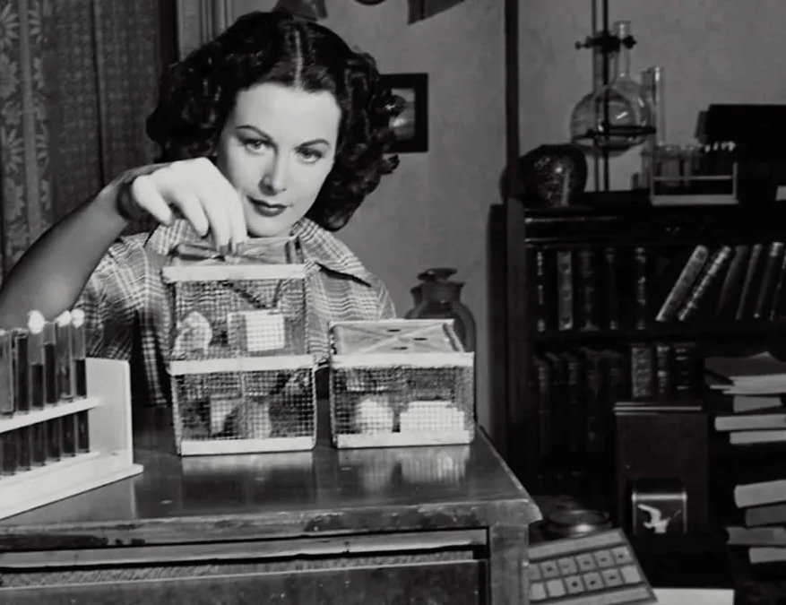
Sources
https://www.sparkfun.com/news/6147 -
https://www.hedylamarr.com/about/biography/
https://www.globalcitizen.org/fr/content/hedy-lamarr-genius-only-seen-for-beauty/
https://www.cmgworldwide.com/2023/11/13/hedy-lamarr-snow-whites-inspiration/
https://rloldershaw.medium.com/great-quotation-at-the-end-of-bombshell-hedy-lamarr-19be9833fa42
http://resourcesforhistoryteachers.pbworks.com/w/page/124612087/Hedy%20Lamarr,%20Actress%20and%20Inventor

